Slide 1
Digital image processing and analysis 4. Colour: Digital representations
Professor Ela Claridge
School of Computer Science

Slide 2
Previous lecture:
Colours and their origins
Physical underpinnings
Human visual perception
Colour images
Image acquisition
Colour spaces

Slide 3
In this lecture we shall find out about:
Digital representation of colour images
Colour mixing (vector arithmetics)
Pixel arrays
Colour models

Slide 4
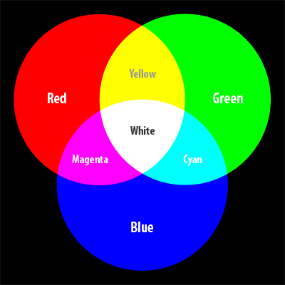
Colour mixing RGB
Mixing in RGB space is additive
Image source: http://www.netsourceinc.com/blog/quick-color-guide

Slide 5
Colour mixing RGB
Vector notation for colours
[ Primary1 Primary2 Primary 3 ]
[ R G B ]
Examples
red = [ 255 0 0 ]
green = [ 0 255 0 ]
blue = [ 0 0 255 ]
yellow = red + green = [ 255 255 0 ]
magenta = red + blue = [255 0 255 ]
cyan = green + blue = [ 0 255 255 ]
orange = [255 127 0 ]
See also: https://www.youtube.com/watch?v=RY8XcwVlwgE

Slide 6
Colour mixing
Colour picker experiment

Slide 7
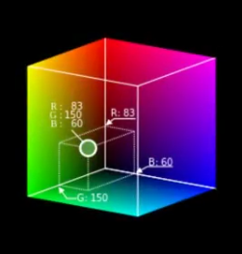
Colour mixing RGB
Given that each primary is represented by 1 byte (8 bits),
how many colours can be represented in total by three primaries?
2^{3x8} = 2²⁴ = 16,777,216

Slide 8
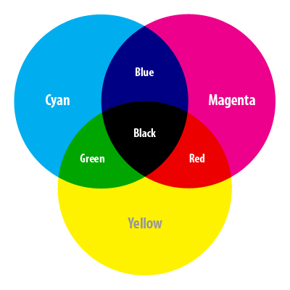
Colour mixing CMY
Mixing in CMY space is subtractive
Image source: http://www.netsourceinc.com/blog/quick-color-guide

Slide 9
Colour mixing CMY
[ C M Y ]
cyan = [ 255 0 0 ] _{CMY}
magenta = [ 0 255 0 ] _{CMY}
yellow = [ 0 0 255 ] _{CMY}
Example: yellow surface
Given white light
[255 255 255] _{RGB}
yellow pigment absorbs blue component of the spectrum
[255 255 255] _{RGB} – [0 0 255] _{RGB} = [255 255 0] _{RGB}
so a mixture of red and green is reflected
[255 255 0] _{RGB} = yellow

Slide 10
Colour space conversion Colour space conversion
Colours can be converted from one space to another
Conversion from RGB to CMY:
[ C M Y ] = [ 255 255 255 ] - [ R G B ]
Example: Convert green from RGB to CMY
[ C M Y ] =
[255 255 255 ] _{RGB} - [ 0 255 0 ] _{RGB} =
[255 0 255 ] _{CMY}

Slide 11
Colour image display
Digital colour images have two components:
raster data - an array of pixels;
colour model - a description of how pixels are mapped to colours.

Slide 12
Colour image display
Computer architecture for colour displays
Pixel values
Computer memory
Frame buffer
Display controller
Monitor
Image
Colour lookup
table
Colour definitions

Slide 13
Colour image display Frame buffer
Frame (display) buffer
A specially designated area of memory
Direct access by a display processor (but not by an application)
Display processor scans the display buffer and passes the contents to a DAC (Digital-to-Analogue Converter)
DAC converts values into voltages for individual R, G and B pixel cells
The colour lookup table is a block of fast RAM (Random Access Memory)

Slide 14
Colour image display Raster data and pixel structure
Raster data - raster array - a rectangular array of picture elements (pixels)
Raster array forms a picture
The structure of a pixel depends on
the colour space
the colour model

Slide 15
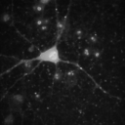
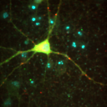
Colour image display Raster data and pixel structure
Binary images (purely black-and-white)
pixel represented by a single bit
Monochrome images
pixel represented by a single byte (a one-dimensional vector)
Colour images
usually represented by a 3-dimensional vector in a given colour space
examples [ R G B], [H S V] or [C M Y]

Slide 16
Colour image display Direct and indexed colour
Direct colour: each pixel encodes its own colour information.
Indexed colour: each pixel does not store colour information, but rather an index into a colour lookup table (LUT). The LUT can contain any colours.

Slide 17
Colour models
A colour model describes how pixels are mapped into colours.

Slide 18
Colour models Direct colour (Packed Array)
Image is an array of values, each encoding a colour
4-byte integer
aaaaaaaa bbbbbbbb gggggggg rrrrrrrr
Alpha-channel
Example:
0 0 255 127

Slide 19
Colour models Direct colour (Packed Array)
Image is an array of values, each encoding a colour
1-byte integer
bbgggrrr
Example:
b b g g g r r r
1 1 1 1 1 0 0 0
Cyan

Slide 20
Colour models Direct colour (True Colour)
Image is an array of vectors
three integer values at each pixel location
Each vector directly encodes values of the three primaries
PixelValue(x,y) = [ R G B ]
e.g. red: [ 255 0 0 ]
3-valued vector

Slide 21
Colour models Direct colour (True Colour)
Image is represented by three channels
three pixel arrays, one for each primary colour
Each channel directly encodes values of one of the three primaries
PixelValue(x,y,r) = R
PixelValue(x,y,g) = G
PixelValue(x,y,b) = B
PixelValue = R
e.g. red
PixelValue = G
PixelValue(x,y,r) = 255
PixelValue = B
PixelValue(x,y,g) = 0
PixelValue(x,y,b) = 0

Slide 22
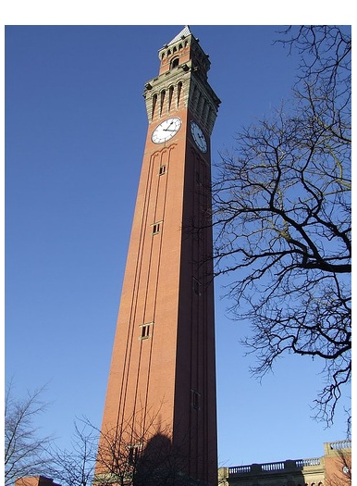
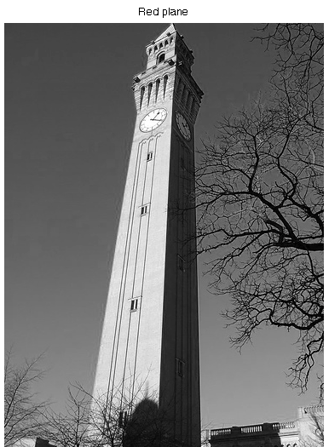
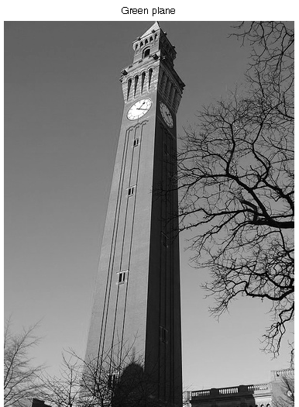
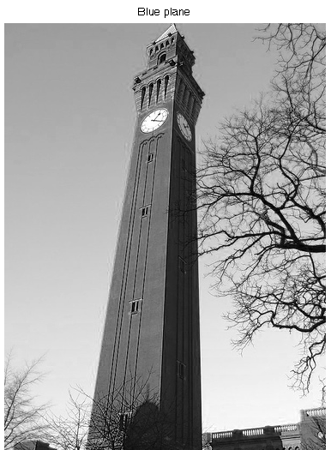
Red channel
Green channel
Blue channel

Slide 23
Colour models Indexed colour
A pixel value (or a value of a pixel component) is an index (a pointer) to a table containing colour definitions

Slide 24
Colour models Indexed colour
Mapping of pixel values to colours
Frame
buffer
Display
Pixel value
R
Colour
definition
Colour lookup table
(LUT)
G
B

Slide 25
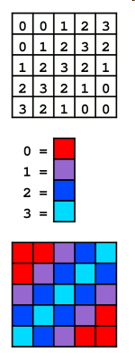
Colour models Indexed colour
Colour lookup table
Synonyms:
Colour Lookup Table
CLUT
LUT
Each location in a LUT stores a colour definition for a pixel with a given value
Raster array
LUT
Display
Source: Wikipedia

Slide 26
Colour models Indexed colour
Changed definition for colour “0” (from red to white)
Raster array
LUT
Display
Source: Wikipedia

Slide 27
Colour models Indexed colour
Colour mapping for 1-byte pixels (8 bit)
117
PixelValue(x,y) = 117
Raster array
LUT address
0
117
255
Pixel colour
Colour lookup
table
R
G
B
0
Display
LUT value at a given address
255
255

Slide 28
Colour models Indexed colour
Colour mapping for 1-byte pixels (8 bit)
Number of colours simultaneously available in one image?
2⁸ = 256
0
117
255
R
Gamut (total number of colours available for use)?
G
B
0
Display
2^{3x8} = 2²⁴ = 16,777,216
255
255

Slide 29
Colour models Indexed colour
Colour mapping for 3-byte pixel vectors (24 bit)
R
G
0
B
255
PixelVector(x,y) = [0 255 0]
0
Colour lookup
table
R
R = 0
G
G = 255
B
B = 0
0
255

Slide 30
Colour models Indexed colour
R
Number of colours simultaneously available in one image?
G
B
2²⁴ = 16,777,216
Gamut (total number of colours available for use)?
R
R
G
G
B
B
2²⁴ = 16,777,216
0
255

Slide 31
Colour models Indexed colour
Changing pixel colours
Changing pixel colours is very easy within the Indexed Colour Model
A raster array containing pixel values (or pixel vectors) stays unchanged.
Only colour definitions in the LUT are changing

Slide 32
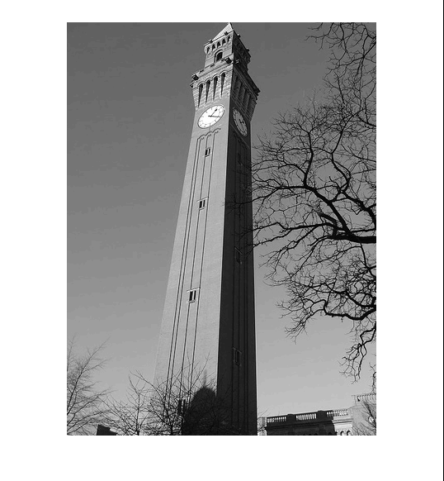
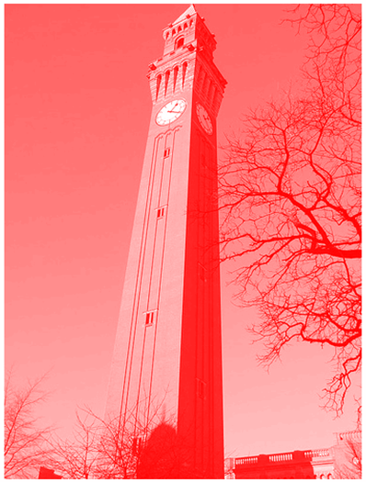
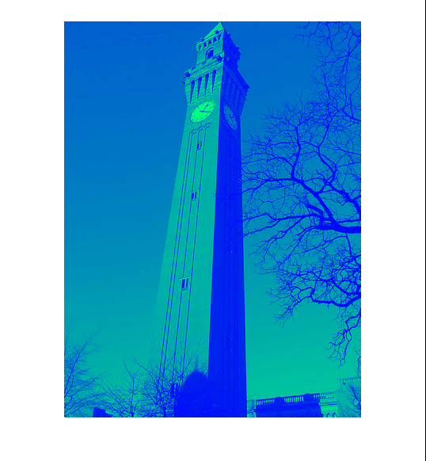
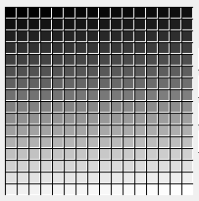
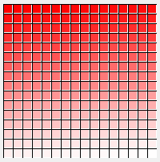
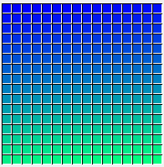
Colour mapping functions
Image
LUT
(256
positions)

Slide 33
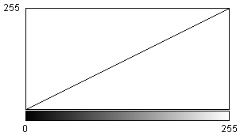
Colour mapping functions
Image
LUT
Colour mapping functions
Magnitude of each of the
3 primaries
Pixel value
(index to colour)

Slide 34
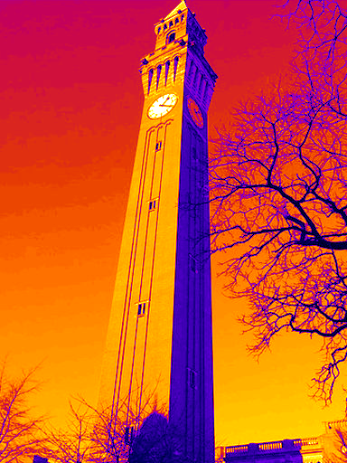
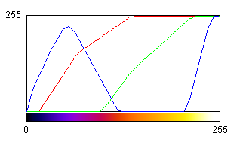
Colour mapping functions
Image
LUT
Colour mapping functions
Magnitude of each of the
3 primaries
Pixel value
(index to colour)

Slide 35
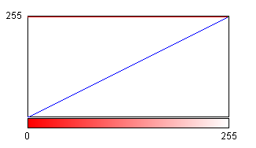
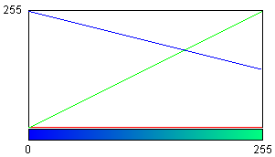
Colour mapping functions
Image
LUT

Slide 36
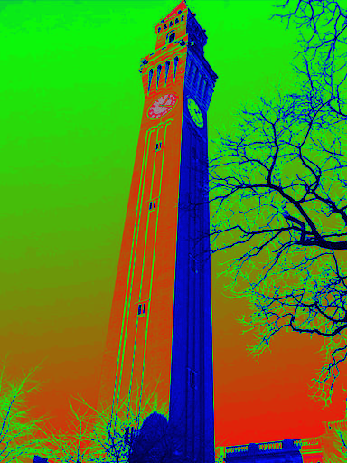
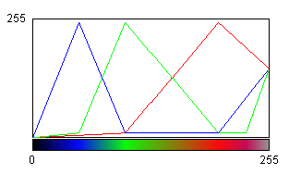
Colour mapping functions

Slide 37
In this lecture we have covered:
Digital representation of colour images
Colour mixing (vector arithmetics)
Pixel arrays
Colour models

Slide 38
Next lecture
Improving image quality
Manipulating image brightness
Contrast enhancement
Image histogram
LUT operations

Slide 39
Further reading and experimentation
RGB colour space
https://en.wikipedia.org/wiki/RGB_color_space
RGB to HSV conversion
http://www.rapidtables.com/convert/color/rgb-to-hsv.htm
Basic vector and matrix arithmetic
http://www.varsitytutors.com/hotmath/hotmath_help/topics/adding-and-subtracting-vectors
https://mathinsight.org/matrix_vector_multiplication
Digital colour concepts
https://en.wikipedia.org/wiki/Colour_look-up_table
https://en.wikipedia.org/wiki/Indexed_color
https://en.wikipedia.org/wiki/Color_depth

Slide 40
You may be interested to know …

Slide 41
Colour spaces (previous lecture) CIE XYZ
G
Chromacity diagram
R
Gamut
B

Slide 42
Colour space conversion RGB to XYZ
Each of the R, G and B primaries is a weighted sum of X, Y and Z primaries
Weights (fractions of each primary) are expressed in matrix notation, e.g.
The matrix values are characteristic for a given
graphics device

Slide 43
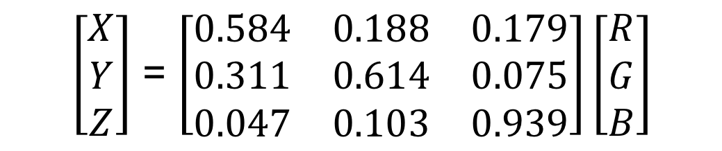
Colour space conversion RGB to XYZ
Conversion implemented as a matrix multiplication
(ROW x COLUMN)
$\left[\begin{aligned}X \\ Y \\ Z\end{aligned}\right]$ = $\left[\begin{matrix}0.584 & 0.188 & 0.179 \\ 0.311 & 0.614 & 0.075 \\ 0.047 & 0.103 & 0.939\end{matrix}\right]\left[\begin{aligned}R \\ G \\ B\end{aligned}\right]$
(This is an example conversion matrix, each device will have its own specific one)

Slide 44
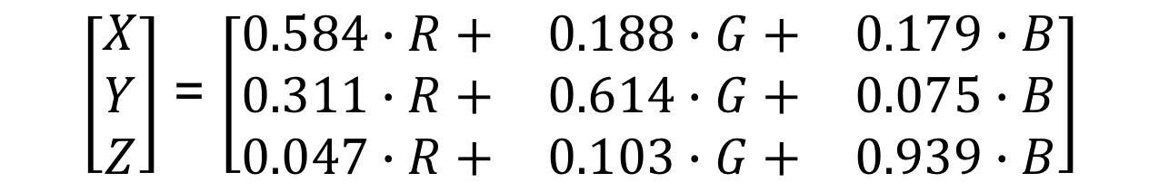
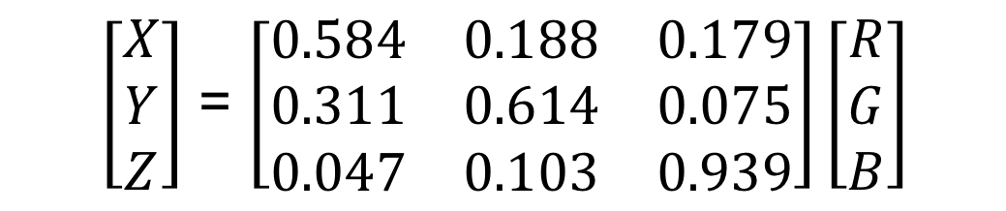
Colour space conversion RGB to XYZ
Conversion implemented as a matrix multiplication
$\left[\begin{aligned}X \\ Y \\ Z\end{aligned}\right]$ = $\left[\begin{matrix}0.584 & 0.188 & 0.179 \\ 0.311 & 0.614 & 0.075 \\ 0.047 & 0.103 & 0.939\end{matrix}\right]\left[\begin{aligned}R \\ G \\ B\end{aligned}\right]$
$\left[\begin{aligned}X \\ Y \\ Z\end{aligned}\right]$ = $\left[\begin{matrix}0.584∙R+ & 0.188∙G+ & 0.179∙B \\ 0.311∙R+ & 0.614∙G+ & 0.075∙B \\ 0.047∙R+ & 0.103∙G+ & 0.939∙B\end{matrix}\right]$

